Slide 1

Hand on Lab VIII: R Language Module

Slide 2
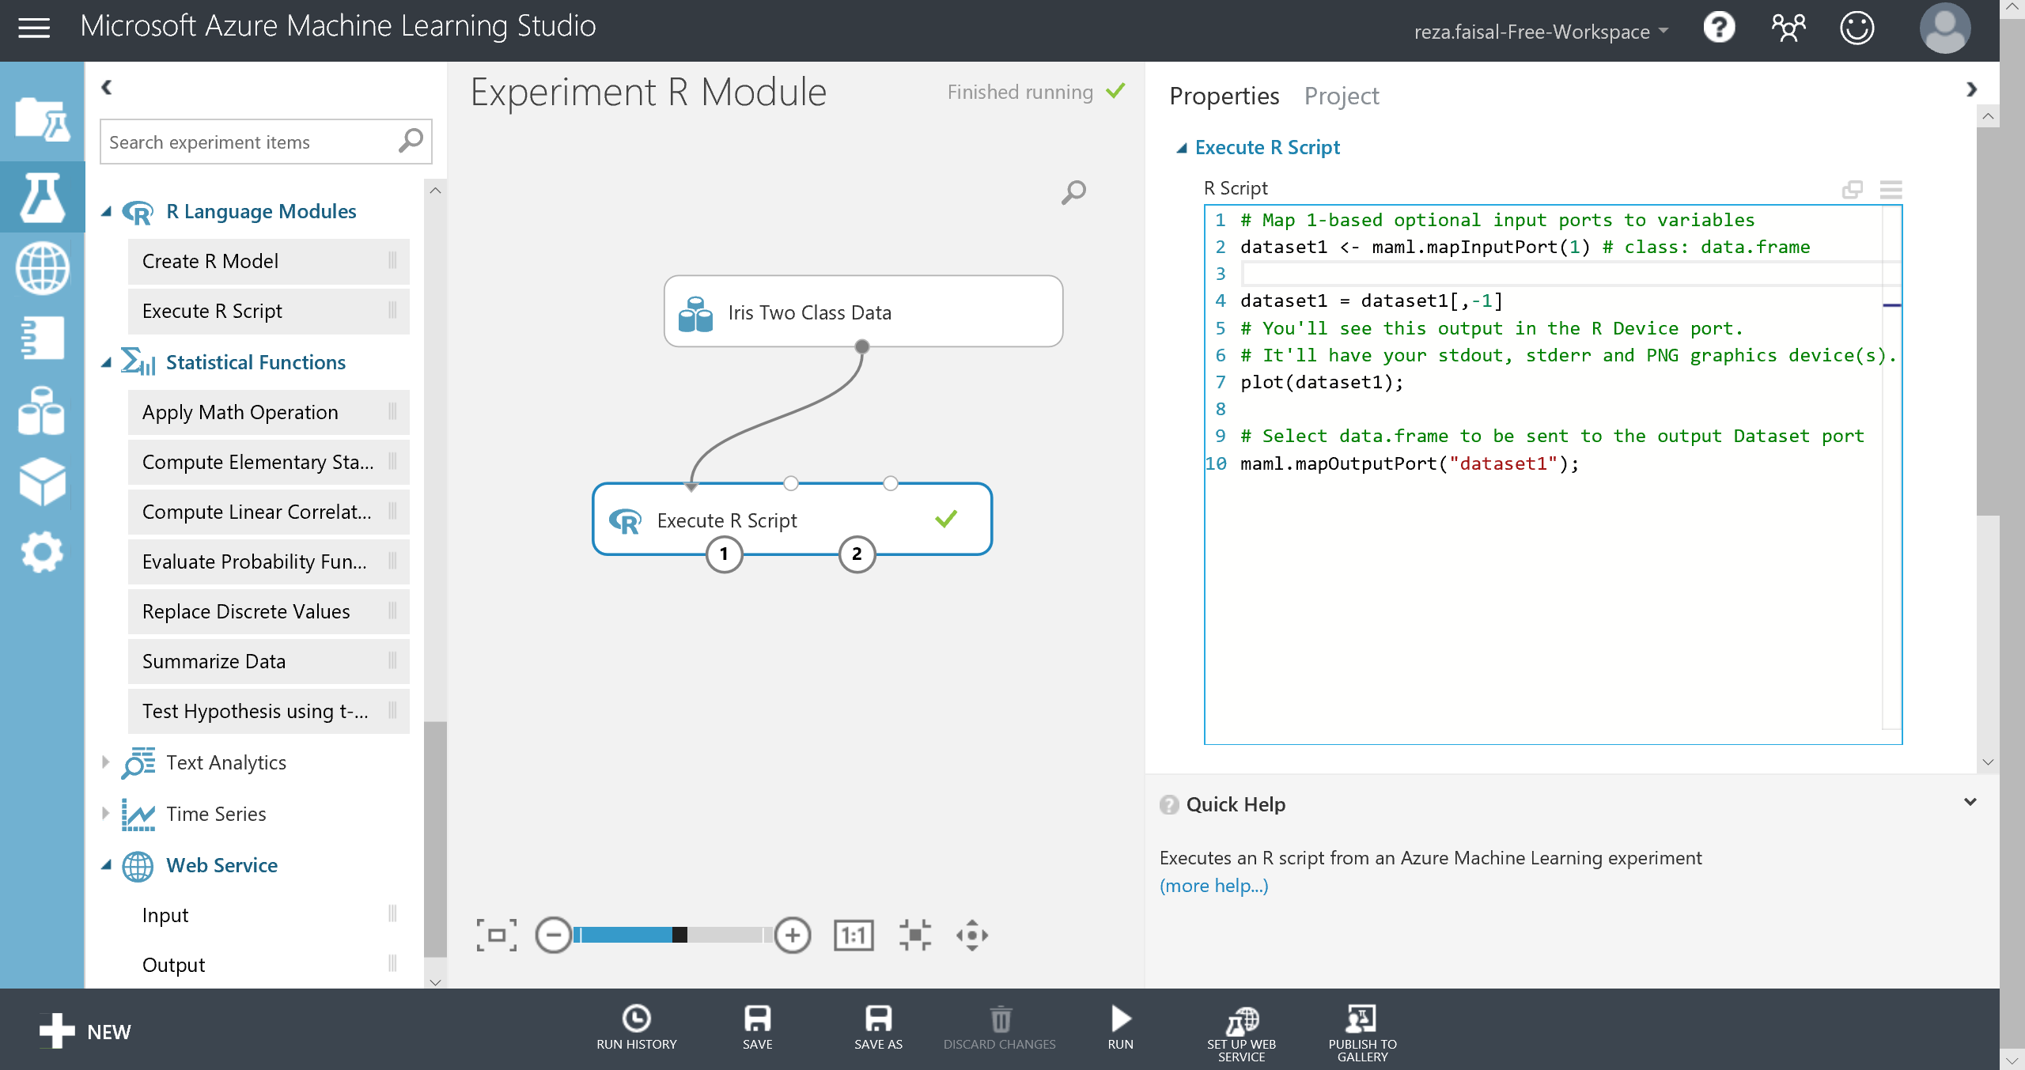
Execute R Script 1/4
Input

Slide 3
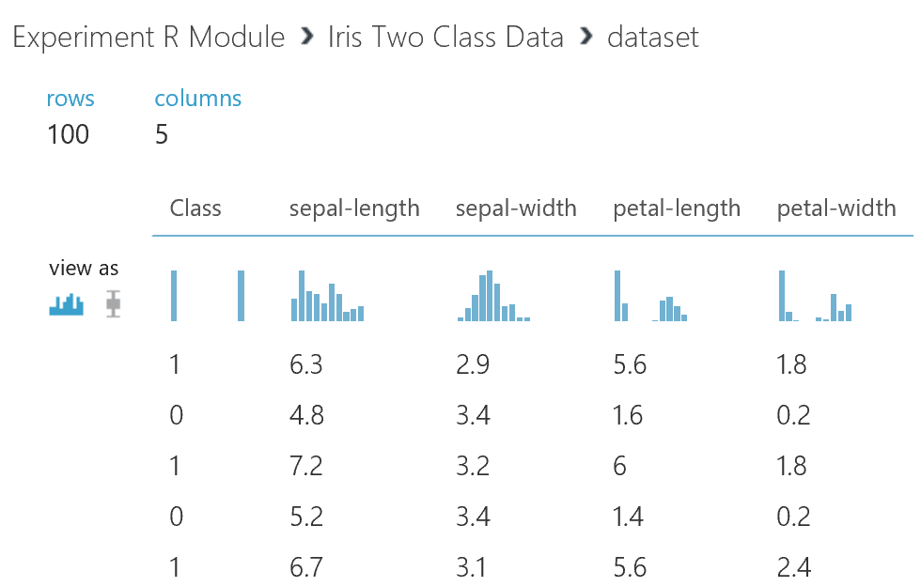
Execute R Script 2/4

Slide 4
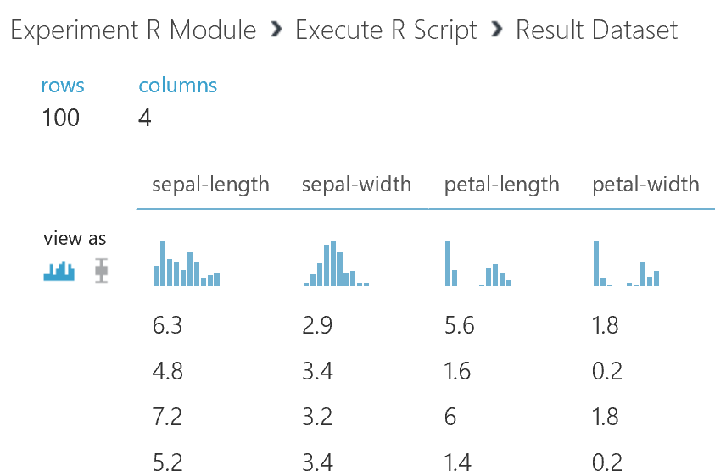
Execute R Script 3/4

Slide 5
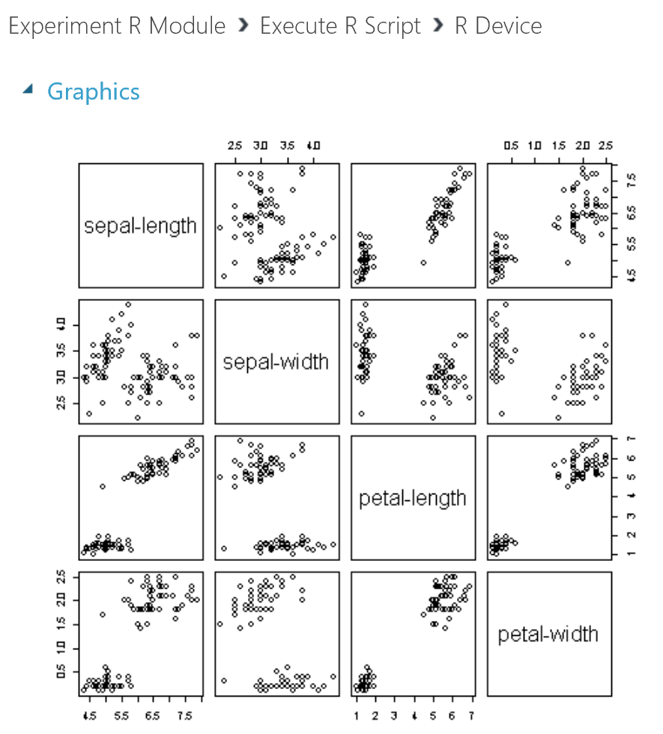
Execute R Script 4/4

